Slide 1
Nanoscale thermal transport
Lecture 2
Riley Hanus
http://rileyhanus.com/science.html

Slide 2
Define (and understand) the phonon band structures
Learn how to read a phonon band structure
Introduction to the phonon gas model
Derive the phonon density of states two ways
Obtain the phonon heat capacity
examine its low frequency and low/high T behavior

Slide 3
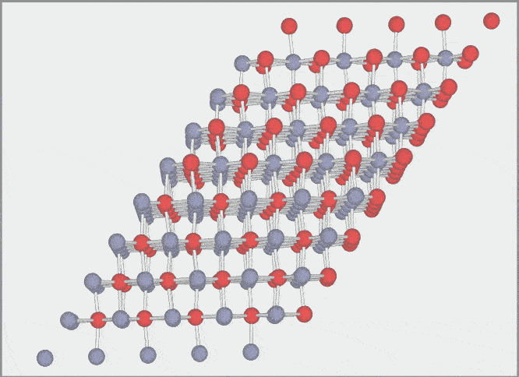
Phonon band structures
Most solid-state physics classes will derive an analytical dispersion for a 1D chain.
If you haven’t seen this, read Kittel, Intro. to Solid State physics Chapter 4.
Much of the intuition gained from the 1D case extends to 3D
The math for a 3D crystal, which is used to calculate real dispersion relations is given in:
Wallace, Thermodynamics of Crystals, Chapter 3.10.
Hanus, Thesis, Section 2.2.1 and Appendix B.
Here we will outline the procedure for computing phonon properties:
frequencies
eigenvectors
(mode shape)

Slide 4
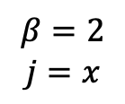
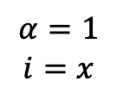
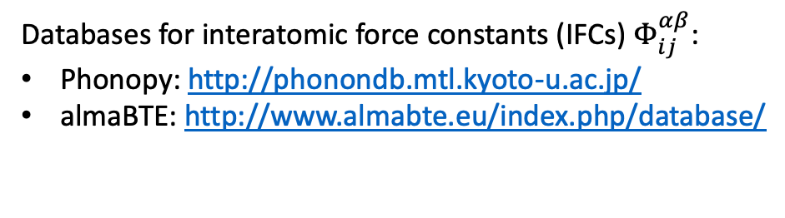
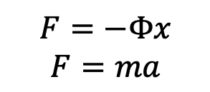
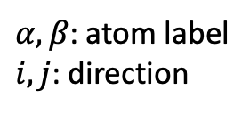
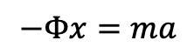
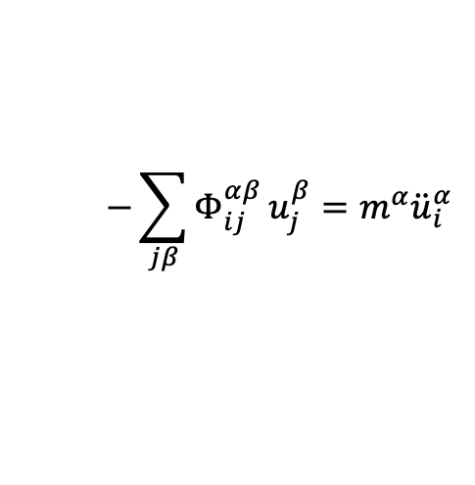
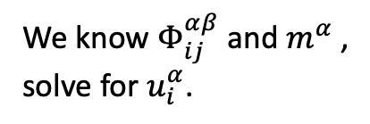
Phonon band structures
Set up
Simply solve the equations of motion (Newton’s law)
$$−Φx=ma$$
$α,β$: atom label
$i, j$: direction
$$F=−Φx$$
$$F=ma$$
$$−\sum_{jβ}{Φ_{ij}^{αβ}}u_{j}^{β}=m^{α}{\ddot{u}}_{i}^{α}$$
$$β=2$$
$$j=x$$
$$α=1$$
$$i=x$$
We know $Φ_{ij}^{αβ}$ and $m^{α}$ ,
solve for $u_{i}^{α}$.
Databases for interatomic force constants (IFCs) $Φ_{ij}^{αβ}$:
Phonopy: http://phonondb.mtl.kyoto-u.ac.jp/
almaBTE: http://www.almabte.eu/index.php/database/

Slide 5
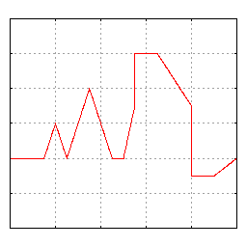
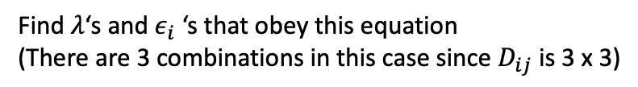
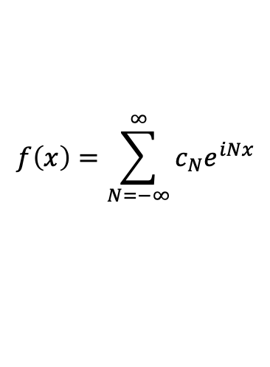
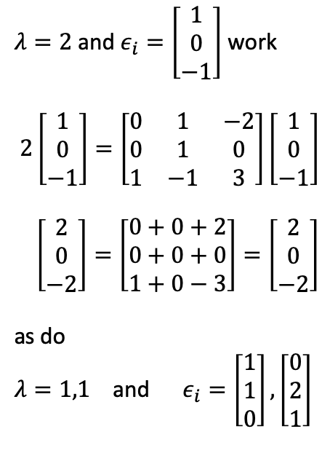
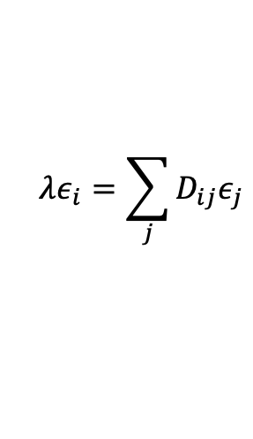
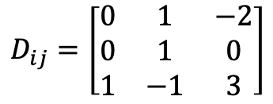

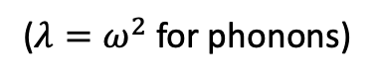
Required math
Expressing a function as a Fourier Series:
$$f\left(x\right)=\sum_{N=−∞}^{∞}{c_{N}e^{iNx}}$$
Matrix diagonalization:
$λ=2$ and $ε_{i}=\left[\begin{matrix}1 \\ 0 \\ −1\end{matrix}\right]$ work
$2\left[\begin{matrix}1 \\ 0 \\ −1\end{matrix}\right]=\left[\begin{matrix}0 & 1 & −2 \\ 0 & 1 & 0 \\ 1 & −1 & 3\end{matrix}\right]\left[\begin{matrix}1 \\ 0 \\ −1\end{matrix}\right]$
$\left[\begin{matrix}2 \\ 0 \\ −2\end{matrix}\right]=\left[\begin{matrix}0+0+2 \\ 0+0+0 \\ 1+0−3\end{matrix}\right]=\left[\begin{matrix}2 \\ 0 \\ −2\end{matrix}\right]$
as do
$λ=1,1$ and $ε_{i}=\left[\begin{matrix}1 \\ 1 \\ 0\end{matrix}\right],\left[\begin{matrix}0 \\ 2 \\ 1\end{matrix}\right]$
$$D_{ij}=\left[\begin{matrix}0 & 1 & −2 \\ 0 & 1 & 0 \\ 1 & −1 & 3\end{matrix}\right]$$
Diagonalize
$$λε_{i}=\sum_{j}{D_{ij}ε_{j}}$$
($λ=ω^{2}$ for phonons)
Find $λ$‘s and $ε_{i}$ ‘s that obey this equation
(There are 3 combinations in this case since $D_{ij}$ is 3 x 3)

Slide 6
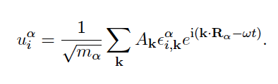
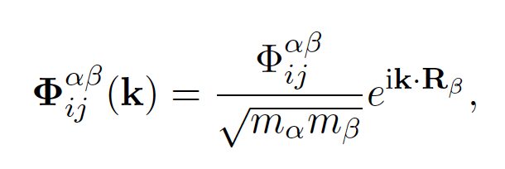
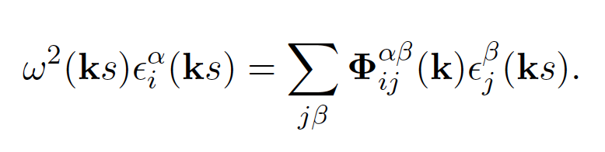
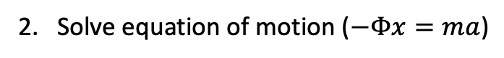
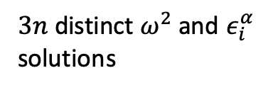
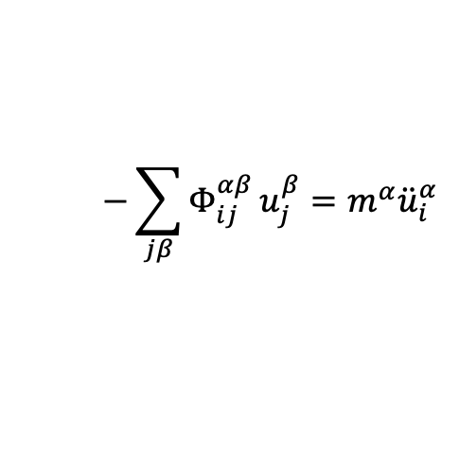
Phonon band structures
Lattice Dynamics
1. Express $u_{i}^{α}$ as a Fourier Series (the Fourier coefficients “$c_{N}$” are a bit more complicated here)
2. Solve equation of motion ($−Φx=ma$)
$$−\sum_{jβ}{Φ_{ij}^{αβ}}u_{j}^{β}=m^{α}{\ddot{u}}_{i}^{α}$$
2a. In solving we find its convenient to define the Dynamical Matrix
2b. Phonon ’eigenstates’ are the solutions you get when you diagonalize the Dynamical Matrix
$3n$ distinct $ω^{2}$ and $ε_{i}^{α}$
solutions
scalar
3n length vector
3n x 3n matrix
3n length vector

Slide 7
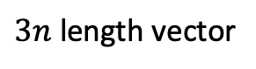
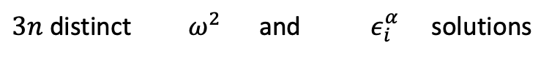
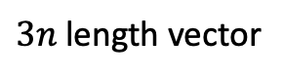
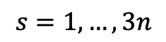
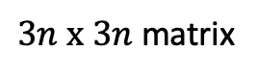
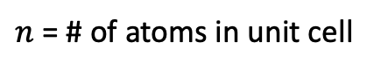
$n$ = # of atoms in unit cell
$$s=1, …, 3n$$
scalar
$3n$ length vector
$3n x 3n$ matrix
$3n$ length vector
$3n$ distinct $ω^{2}$ and $ε_{i}^{α}$ solutions

Slide 8
Phonon band structures
In practice
Find solutions (diagonalize the Dynamical Matrix)
Along special directions to plot
pretty band structures:
On a mesh to sample the entire Brillouin Zone, when we want transport properties of density of states:
Computational suites that do this:
phonopy: https://atztogo.github.io/phonopy/
almaBTE: http://www.almabte.eu/
shengBTE: http://www.shengbte.org/

Slide 9
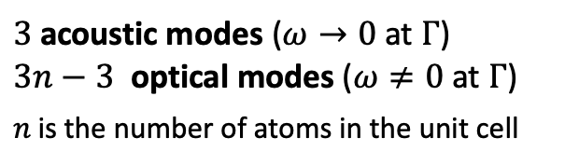
Reading a phonon band structure
$3$ acoustic modes ($ω→0$ at $Γ$)
$3n−3$ optical modes ($ω≠0$ at $Γ$)
$n$ is the number of atoms in the unit cell
Ultrasound, speed of sound,
Elastic tensor and moduli,
Bulk modulus, Young’s modulus,
etc.

Slide 10
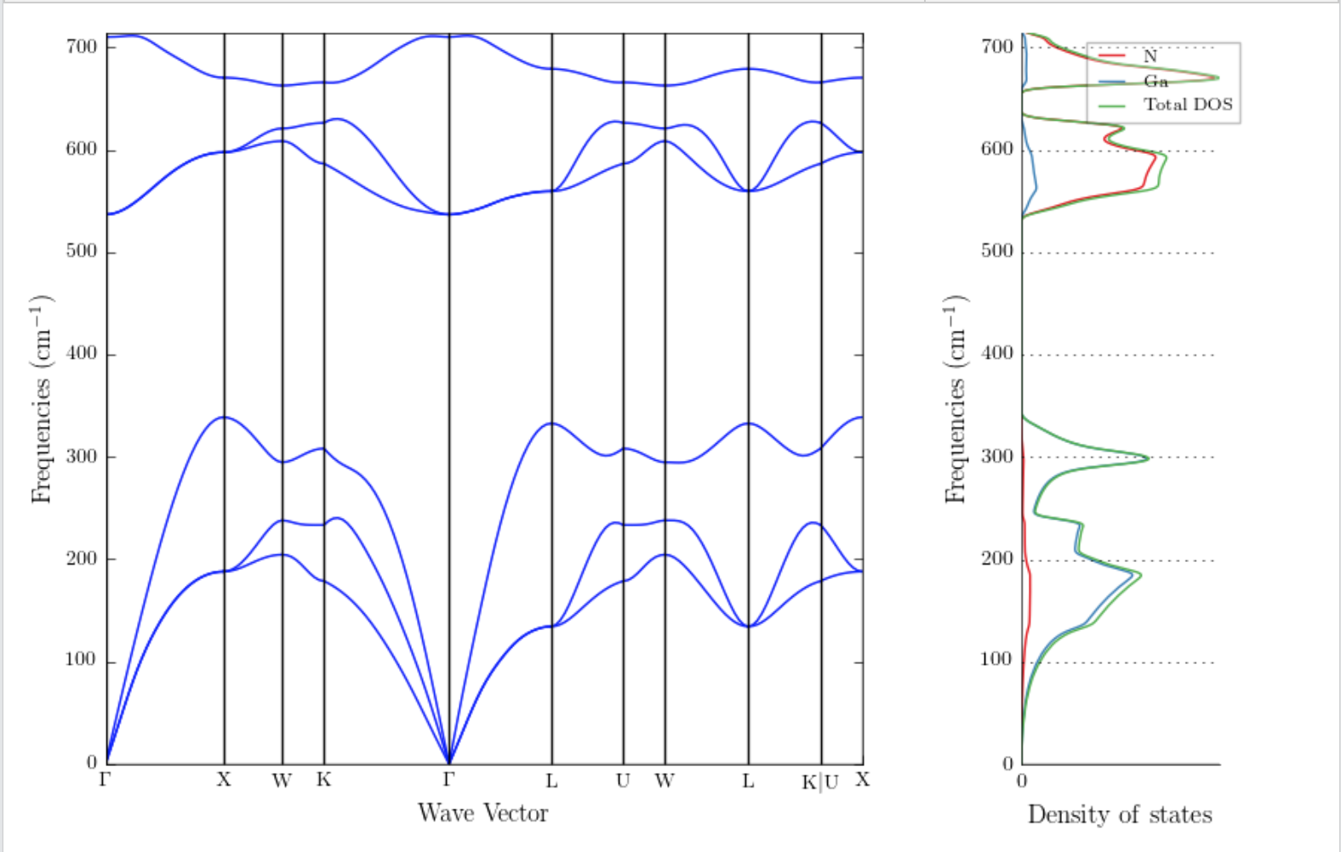
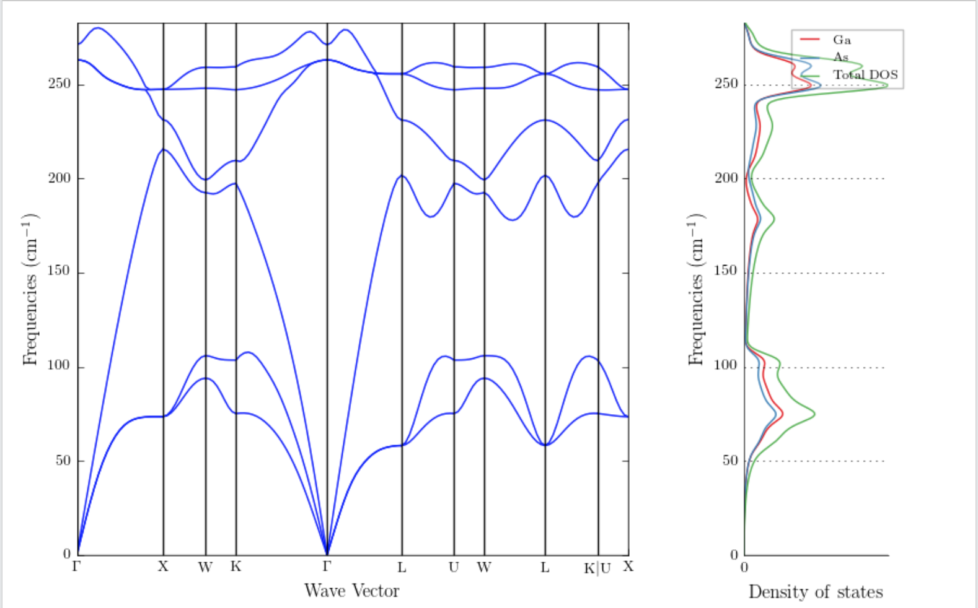
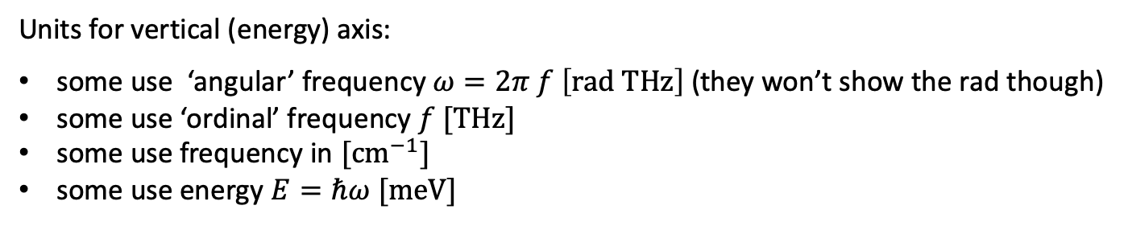
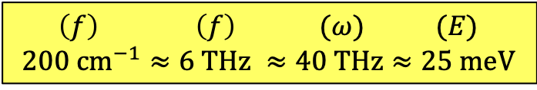
Reading a phonon band structure
Effect of atomic mass and the
phonon band gap.
Cubic GaN: N mass = 14 amu
Cubic GaAs: As mass = 75 amu
25 meV
25 meV
Units for vertical (energy) axis:
some use ‘angular’ frequency $ω=2π f \left[rad THz\right]$ (they won’t show the rad though)
some use ‘ordinal’ frequency $f [THz]$
some use frequency in $[cm^{−1}]$
some use energy $E=ℏω [meV]$
$$\left(f\right) \left(f\right) (ω) (E)$$
$$200 cm^{−1}≈6 THz ≈40 THz≈25 meV$$

Slide 11
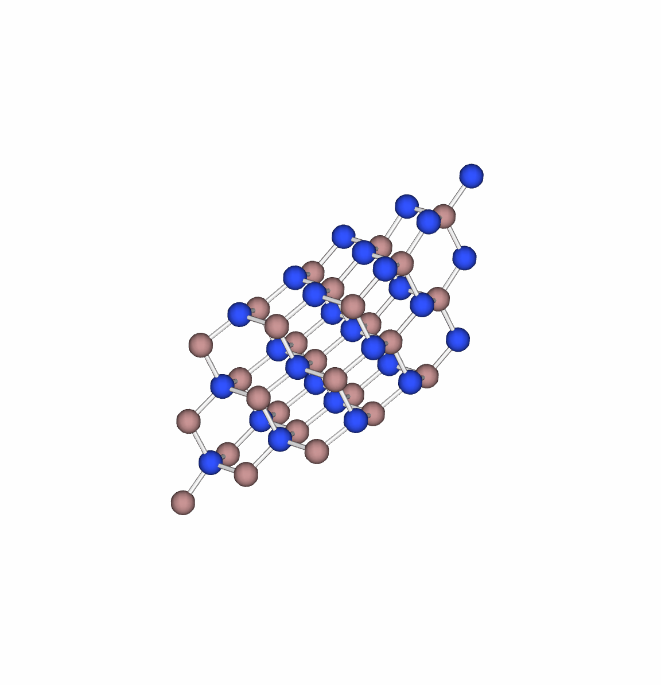
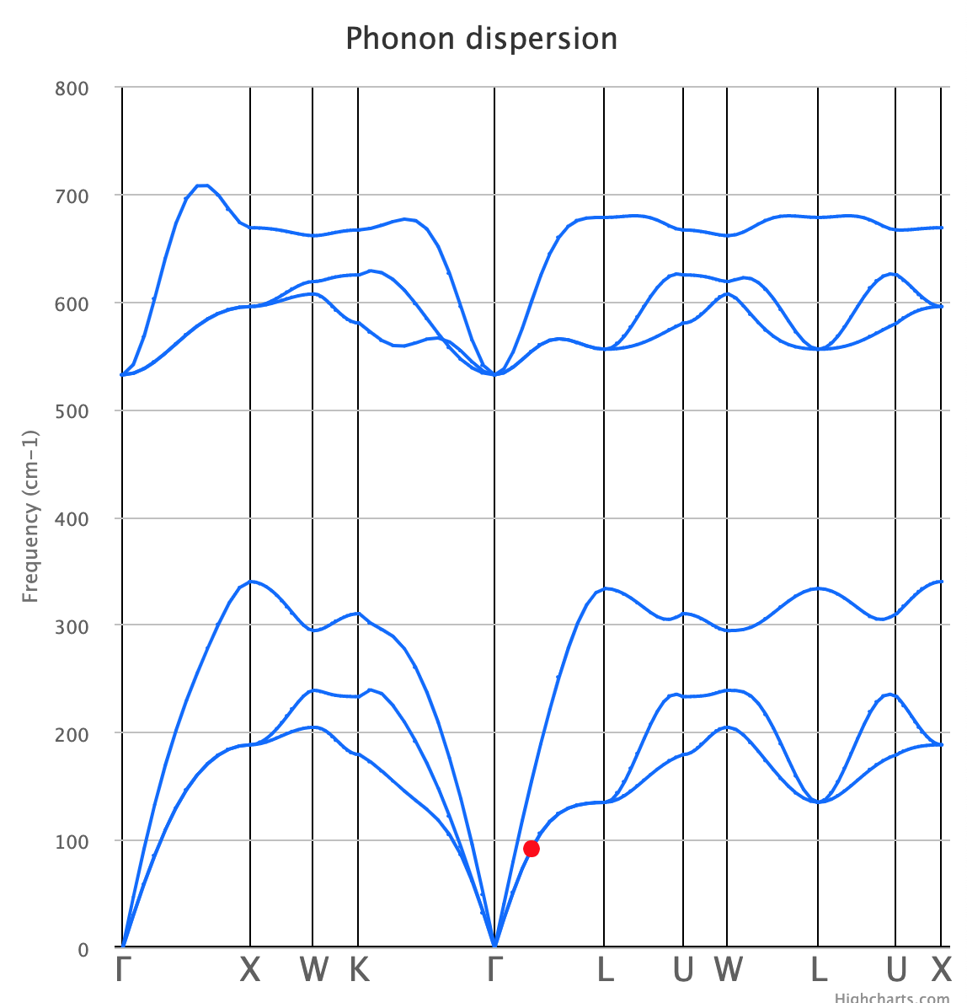
Ga: Brown
N: Blue
https://henriquemiranda.github.io/phononwebsite/phonon.html
magnitude of atomic displacement dramatically exaggerated

Slide 12
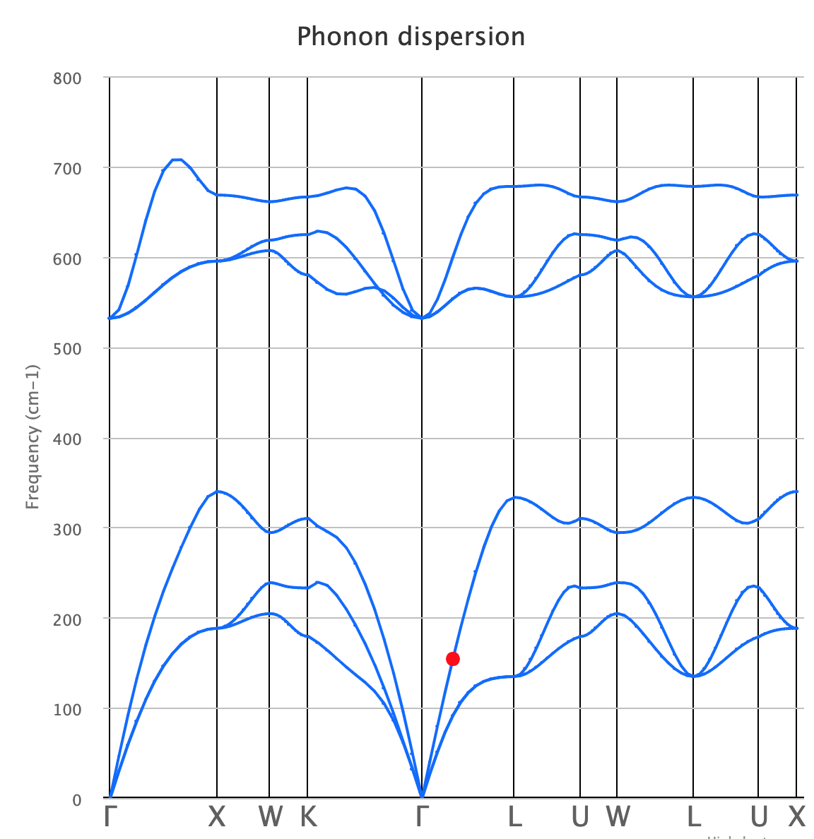
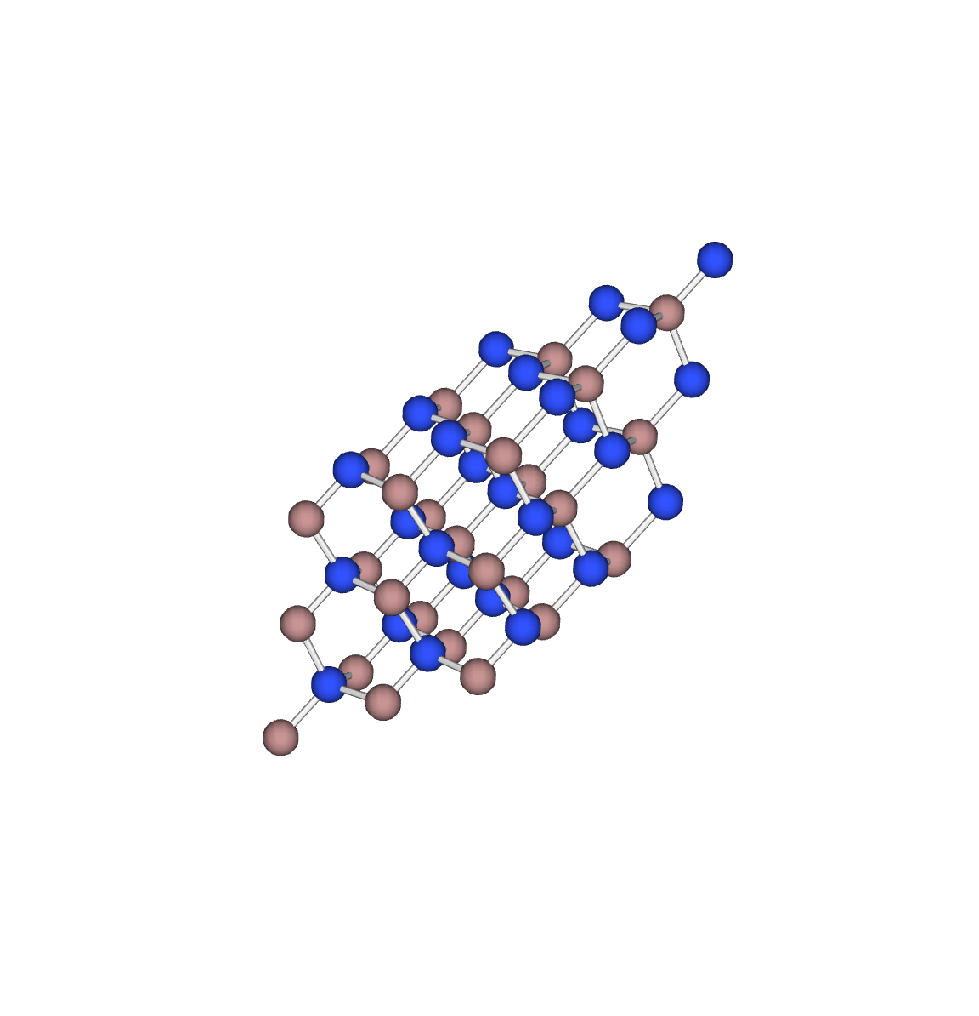
magnitude of atomic displacement dramatically exaggerated

Slide 13
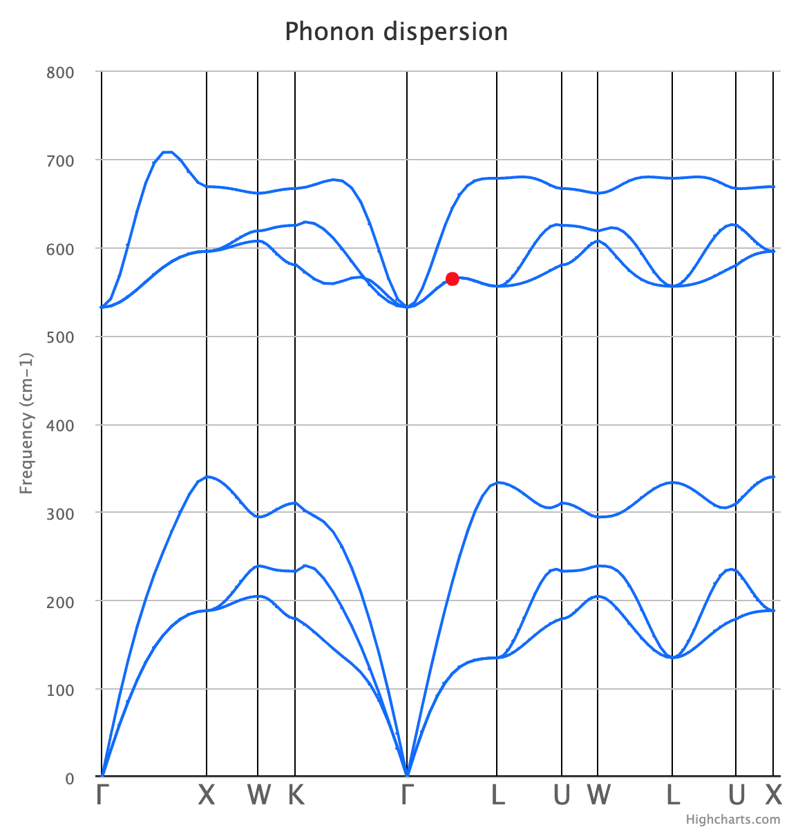
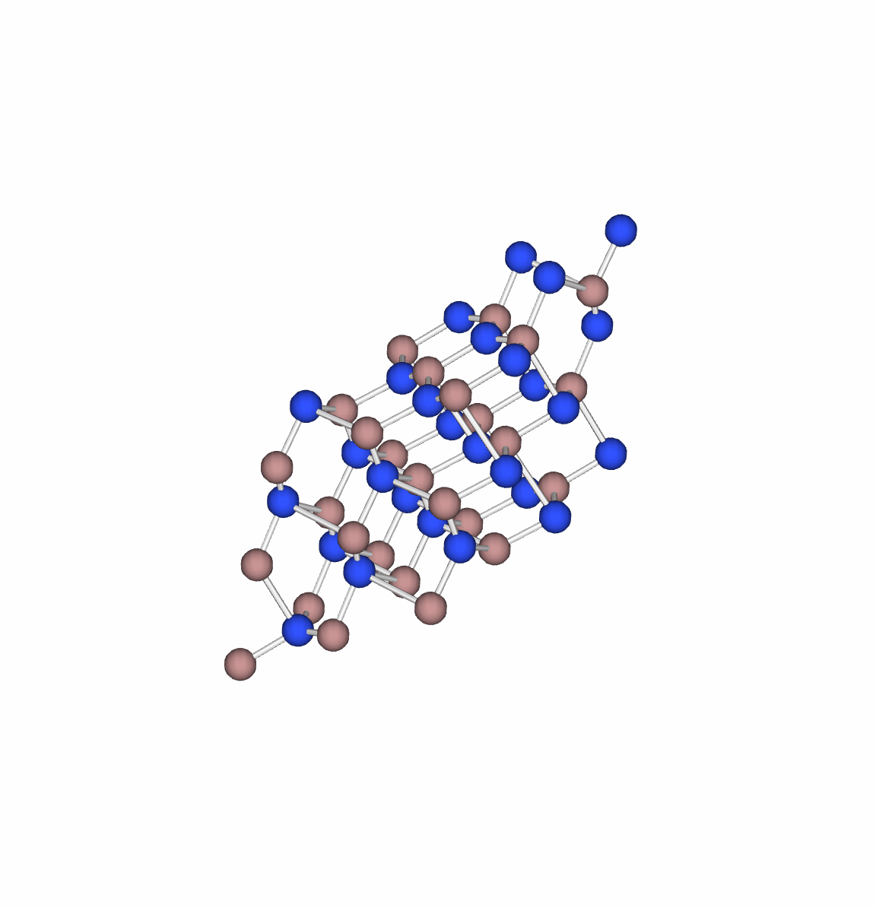
magnitude of atomic displacement dramatically exaggerated

Slide 14
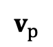
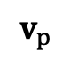
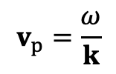
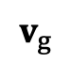
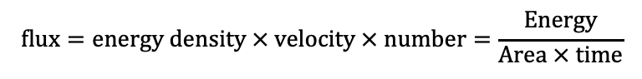
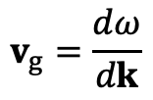
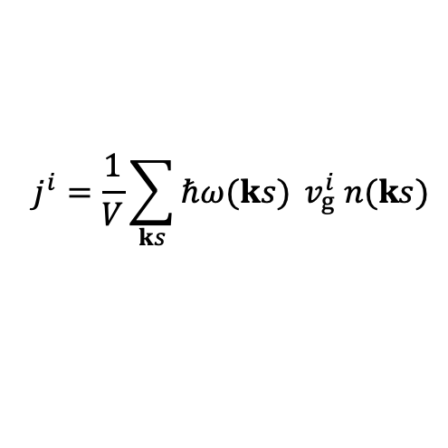
Reading a phonon band structure
Group velocity and phase velocity
$$v_{p}$$
$$v_{g}=\frac{dω}{dk}$$
$$v_{p}=\frac{ω}{k}$$
$$v_{p}$$
$$v_{g}$$
$$flux=energy density × velocity × number=\frac{Energy}{Area × time}$$
Phonon-gas model for heat flux:
$$j^{i}=\frac{1}{V}\sum_{ks}{ℏω(ks)} v_{g}^{i} n(ks)$$

Slide 15
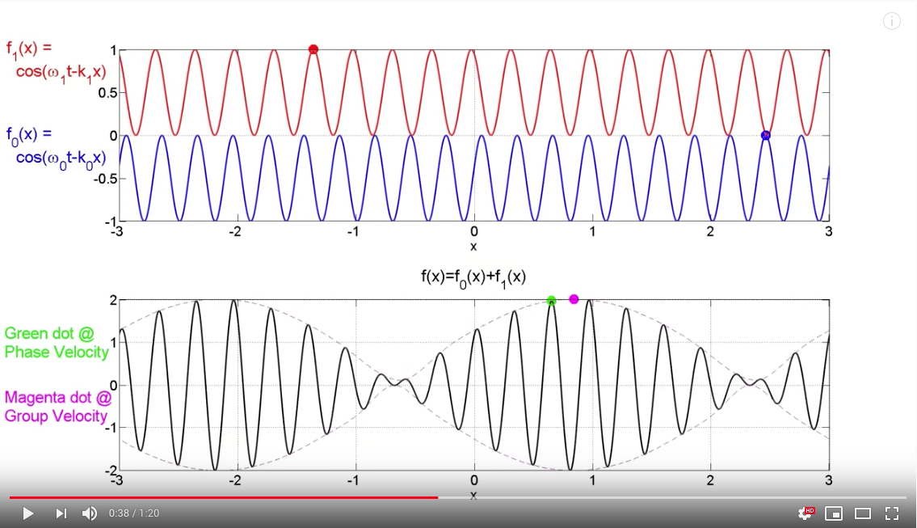
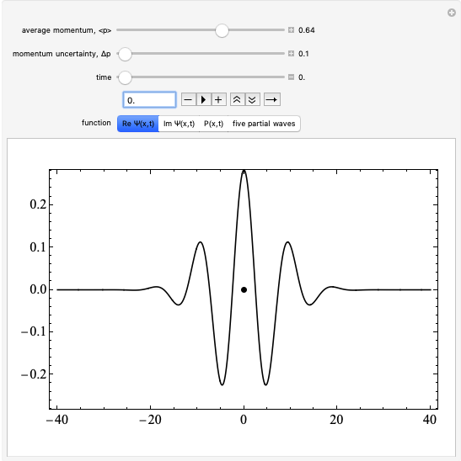
Wave packets
Group and phase velocity
https://www.youtube.com/watch?v=tlM9vq-bepA
https://demonstrations.wolfram.com/WavepacketForAFreeParticle/

Slide 16
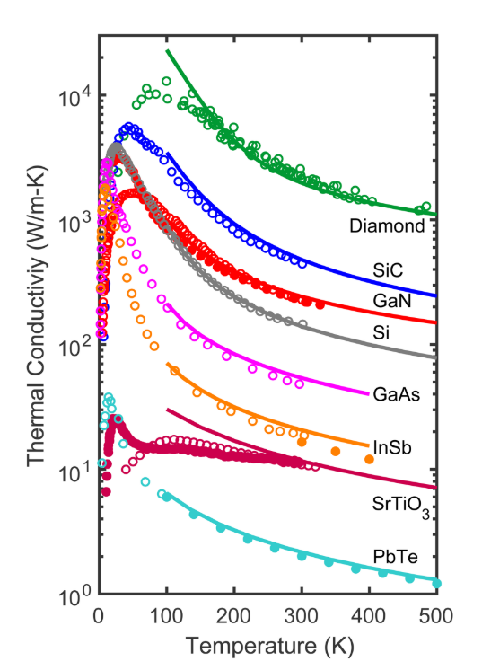

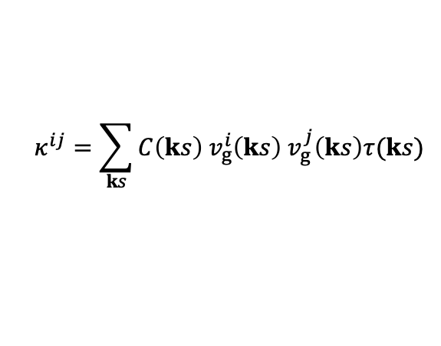

The phonon gas model
Lines are all:
DFT obtained interatomic force constants ($Φ_{ij}^{αβ}$ and $Φ_{ijk}^{αβγ}$)
Phonon properties from lattice dynamics
Thermal conductivity from the phonon gas model
First principles simulation, no adjustable parameters… but there are choices
$$κ^{ij}=\sum_{ks}{C\left(ks\right) v_{g}^{i}\left(ks\right) v_{g}^{j}\left(ks\right)τ(ks)}$$
=
McGaughey, A. J. H., Jain, A. & Kim, H. Phonon properties and thermal conductivity from first principles, lattice dynamics, and the Boltzmann transport equation. J. Appl. Phys. 125, 011101 (2019).
Notes:
… except:
what exchange correlation functional you decide to use
what DFT parameters you use for $Φ_{ij}^{αβ}$ and $Φ_{ijk}^{αβγ}$
k-mesh density (hopefully converged)
cutoff energy (hopefully converged)
How you found all of the possible 3 phonon scattering processes (Gaussian smearing, search algorithm)
How you perform your Brillouin zone integration
uniform k-mesh? cylindrical k-mesh?
Whether or not you included crystal boundary scattering, i.e. a maximum allowed mean free path

Slide 17



The phonon gas model
$$κ^{ij}=\sum_{ks}{C\left(ks\right) v_{g}^{i}\left(ks\right) v_{g}^{j}\left(ks\right)τ(ks)}$$
Mode specific treatment:
(computational approach)
$$κ=\frac{1}{3}\int_{0}^{∞}{C\left(ω\right) v_{g}{\left(ω\right)}^{2} τ(ω)} dω$$
Spectral treatment:
(Callaway modeling)
Where we define:
$$C\left(ω\right)= \sum_{ks}{C\left(ks\right)δ(ω−ω(ks))}$$
$$v_{g}\left(ω\right)=\frac{\sum_{ks}{v_{g}\left(ks\right)}δ(ω−ω(ks))}{\sum_{ks}{δ(ω−ω(ks))}}$$
$$τ\left(ω\right)=\frac{\sum_{ks}{τ(ks)}δ(ω−ω(ks))}{\sum_{ks}{δ(ω−ω(ks))}}$$
The spectral model can be thought as containing the mode specific properties “under the hood”.
Often, in real (defective) materials, we don’t have access to full mode specific properties, and therefore use the spectral treatement.

Slide 18

The phonon gas model

Slide 19


Density of states
How many states are at given energy?
Cubic GaN
When branches are linear
$${g(ω)∝ω}^{2}$$
, $g(ω)$
where group velocity goes to zero at the BZ edge = “Van Hove singularity” = peak in density of states

Slide 20





Density of states
Probably the most common derivation.
We will just examine one branch.
$N$: number of states
$V$: crystal volume
$k$: magnitude of the k-vector
${\left(2π\right)}^{3}/V$: volume of k-space
$$N(ω)\frac{{\left(2π\right)}^{3}}{V}=\frac{4}{3}π k^{3}$$
$n(ω)=\frac{N(ω)}{V}$: number of states per volume
$g\left(ω\right)=\frac{dn(ω)}{dω}$: a definition of the phonon density of states
assert a Debye model for phonon dispersion relation (band structure): $ω=v_{s}k$
$$n(ω)=\frac{1}{6π^{2}}\frac{ω^{3}}{v_{s}^{3}}$$
$$g\left(ω\right)=\frac{dn(ω)}{dω}=\frac{1}{2π^{2}}\frac{ω^{2}}{v_{s}^{3}}$$
Notice:
This derivation does not
predict Van Hove singularities

Slide 21

















Density of states
Another derivation which is a more informative and will introduce us to some math which is important in scattering theory
Required math:
Converting sums to integrals:
Integrating over delta functions:
$$\frac{1}{N_{k}}\sum_{k}{f\left(k\right)} →\frac{V}{{\left(2π\right)}^{3}}\iiint{f\left(k\right)dk_{x}dk_{y}dk_{z}}$$
$$\int{f\left(x\right) δ\left(x−x_{0}\right) dx}=f(x_{0})$$
$$\frac{1}{N_{k}}\sum_{k}{f\left(k\right)} → \frac{V}{{\left(2π\right)}^{3}}\int{f\left(k\right)d^{3}k}$$
$$f(x)$$
$$×$$
$$δ(x−x_{0})$$
$N_{k}$: number of k-vectors considered in the sum
$V$: is the volume of the unit cell
$$x$$
$$x_{0}$$
$$x$$
$$x_{0}$$
The sum introduces no units.
The integral comes with $d^{3}k$, which has a value of ${\left(2π\right)}^{3}/V$ after integrating over the FBZ.
Instructive exercise:
Pretend $f\left(k\right)=1$ and compute both.
Hint: $\int{d^{3}k}={\left(2π\right)}^{3}/V$
$$=$$
$$f\left(x\right) δ(x−x_{0})$$
$$x$$
$$x_{0}$$
Note the units:
if $x$ (and therefore $dx$) has units of $[m]$
then $δ(x)$ has units of $\left[\frac{1}{m}\right]$

Slide 22

Density of states
A second definition of the density of states:
$$g\left(ω\right)=\frac{1}{VN_{k}}\sum_{ks}{δ(ω−ω(ks))}$$
small DOS
(1) pick a frequency/energy
large DOS
(2) search through the whole FBZ and count all modes at that energy

Slide 23






on board
Density of states
$$g\left(ω\right)=\frac{1}{VN_{k}}\sum_{ks}{δ(ω−ω(ks))}$$
For comparison we will only look at one branch, so only $s=1$.
Therefore, we don’t need the sum over $s$.
$$g\left(ω\right)=\frac{1}{VN_{k}}\sum_{k}{δ(ω−ω(k))}$$
Convert sum to an integral
$$g\left(ω\right)=\frac{1}{V}\frac{V}{{\left(2π\right)}^{3}}\int{δ\left(ω−ω\left(k\right)\right)d^{3}k}$$
Cancel $V$, and switch to spherical coordinates.
$$g\left(ω\right)=\frac{1}{{\left(2π\right)}^{3}}\iiint_{−∞ 0 0}^{∞ π 2π}{δ\left(ω−ω\left(k\right)\right)}\sin{θ k^{2}}dφdθdk$$

Slide 24







on board
Density of states
$$g\left(ω\right)=\frac{1}{{\left(2π\right)}^{3}}\iiint_{0 0 0}^{k_{max} π 2π}{δ\left(ω−ω\left(k\right)\right)}\sin{θ k^{2}}dφdθdk$$
Now we make the isotropic assumption, by saying that $ω(k)$ no longer depends on the direction $k$ is pointing, but only on its magnitude $ω(k)$.
After this, we can take the integrals over $θ$ and $φ$: $\iint{\sin{θ dφ dθ=4π}}$
$$g\left(ω\right)=\frac{4π}{{\left(2π\right)}^{3}}\int_{0}^{k_{max}}{δ(ω−ω(k))}k^{2}dk$$
Need to convert the integral such that its over $ω$ so we can take advantage of that $δ$-function. We use our definitions of group and phase velocity to do this.
$$v_{g}=\frac{dω}{dk}$$
$$v_{p}=\frac{ω}{k}$$
$$g\left(ω\right)=\frac{1}{2π^{2}}\int_{0}^{ω_{max}}{δ(ω−ω(k))}\frac{ω^{2}}{v_{p}^{2}}\frac{dω}{v_{g}}$$
$$g\left(ω\right)=\frac{1}{2π^{2}}\frac{ω^{2}}{v_{p}^{2}v_{g}}$$
Finally, we take the integral.

Slide 25









$$g\left(ω\right)=\frac{1}{2π^{2}}\frac{ω^{2}}{v_{p}^{2}v_{g}}$$
on board
Density of states
For a linear dispersion $v_{g}=v_{p}=v_{s}$
Currently we are only looking at
only one branch. Sometimes we approximate all three acoustic branches as one branch with average group and phase velocities.
$$g\left(ω\right)=\frac{1}{2π^{2}}\frac{ω^{2}}{v_{s}^{3}}$$
(same as first derivation)
$$g\left(ω\right)≅\frac{3}{2π^{2}} \frac{ω^{2}}{v_{p}^{2}v_{g}}$$
keep in mind $v_{g}$ and $v_{p}$
can change with $ω$
$$v_{g}=\frac{dω}{dk}$$
$$g\left(ω\right)=\frac{3}{2π^{2}}\frac{ω^{2}}{v_{p}{\left(ω\right)}^{2}v_{g}(ω)}$$
When $v_{g}\left(ω\right)=0$, $g\left(ω\right)=∞$
and that is our
Van Hove singularity
$$v_{p}=\frac{ω}{k}$$

Slide 26




on board
Heat capacity
$$C\left(ω\right)=\frac{d E(ω,T)}{dT}$$
Heat capacity is the change in energy with temperature
We will look for the spectral heat capacity per unit volume
Energy density: $E\left(ω,T\right)=ℏω n(ω,T)$
Number density of phonons: $n\left(ω,T\right)=g\left(ω\right) n_{BE}(ω,T)$
Note:
$g(ω)$ is the number of possible states per unit volume. Here, we say it doesn’t change with temperature (i.e. the quasi-harmonic approximation). In reality thinks get softer with increasing temperature so $g\left(ω\right)$ will shift down in $ω$ as $T$ increases.
$n_{BE}(ω,T)$ is the occupation number (can think of it as an occupation probability), of a state at frequency/energy $ω$, and temperature $T$.
$$\frac{d E(ω,T)}{dT}=ℏω g\left(ω\right)\frac{d n_{BE}(ω,T)}{dT}$$

Slide 27





on board
Heat capacity
$$n_{BE}=\frac{1}{e^{\frac{ℏω}{k_{B}T}}−1}$$
Crazy triple chain rule
$$\frac{dn_{BE}}{dT}=\frac{(−1)}{{\left(e^{\frac{ℏω}{k_{B}T}}−1\right)}^{2}} ×{ e}^{\frac{ℏω}{k_{B}T}} × \frac{\left(−1\right)ℏω}{k_{B}T}=\frac{ℏω }{k_{B}T^{2}}\frac{e^{\frac{ℏω}{k_{B}T}}}{{\left(e^{\frac{ℏω}{k_{B}T}}−1 \right)}^{2}}$$
$$C\left(ω\right)=ℏω g\left(ω\right)\frac{dn_{BE}}{dT}=ℏω × \frac{3}{2π^{2}}\frac{ω^{2}}{v_{p}^{2}v_{g}} ×\frac{ℏω }{k_{B}T^{2}}\frac{e^{\frac{ℏω}{k_{B}T}}}{{\left(e^{\frac{ℏω}{k_{B}T}}−1 \right)}^{2}}$$
Heat capacity per volume
$$C=\int_{0}^{ω_{max}}{C(ω)} dω$$
$$C\left(ω\right)=\frac{3}{2π^{2}}\frac{ω^{4}}{v_{g}v_{p}^{2}}\frac{ℏ^{2}}{k_{B}T^{2}}\frac{e^{ℏω/k_{B}T}}{{\left(e^{ℏω/k_{B}T}−1\right)}^{2}}$$

Slide 28







on board
Heat capacity
Let’s look at the low $ω$ behavior
$$C\left(ω\right)=\frac{3}{2π^{2}}\frac{ω^{4}}{v_{g}v_{p}^{2}}\frac{ℏ^{2}}{k_{B}T^{2}}\frac{e^{ℏω/k_{B}T}}{{\left(e^{ℏω/k_{B}T}−1\right)}^{2}}$$
If I just plug in $ω=0, C\left(ω\right)=0/0$.
Not super helpful, what we really want is the limiting behavior.
Define:
$$x=\frac{ℏω}{k_{B}T}$$
Taylor expand $e^{x}$ about $x=0$.
$$e^{x}≈1+x+…$$
$$C\left(ω\right)=\frac{3}{2π^{2}}\frac{ ω^{4}}{v_{p}^{2}v_{g}}\frac{ℏ^{2}}{k_{B}T^{2}} \frac{ (1)}{{\left(1+x−1\right)}^{2}}=\frac{3 }{2π^{2}}\frac{ω^{4}}{v_{p}^{2}v_{g}}\frac{ℏ^{2}}{k_{B}T^{2}}{\left(\frac{k_{B}T}{ℏω}\right)}^{2}=k_{B}\frac{3}{2π^{2}}\frac{ω^{2}}{v_{p}^{2}v_{g}}$$
At high T and or low $ω$
$$C\left(ω\right)=k_{B} g(ω)$$
which means $C→cst$ at high T
and $C\left(ω\right)∝ω^{2}$ when the dispersion is linear

Slide 29








on board
Heat capacity
Let’s look at low and high $T$ behavior
Convenient to convert the integral to be over the dimensionless parameter $x$.
$$x=\frac{ℏω}{k_{B}T}$$
$$dω=\frac{k_{B}T dx}{ℏ}$$
$$x_{max}=\frac{ℏω_{max}}{k_{B}T}$$
$$C=\frac{3}{2π^{2}}\frac{ℏ^{2}}{k_{B}T^{2}}\int_{0}^{ω_{max}}{\frac{ω^{4}}{v_{g}v_{p}^{2}}\frac{e^{ℏω/k_{B}T}}{{\left(e^{ℏω/k_{B}T}−1\right)}^{2}}}dω$$
$$C=\frac{3}{2π^{2}}\frac{k_{B}^{4}T^{3}}{ℏ^{3}}\int_{0}^{x_{max}}{\frac{x^{4}}{v_{g}v_{p}^{2}}\frac{e^{x}}{ {\left(e^{x}−1\right)}^{2}}dx}$$
At low T:
only low frequency modes are populated, $v_{g}=v_{p}=v_{s}$
$x_{max}→∞$
At low T
where dispersion is linear:
$$C∝T^{3}$$
$$\int_{0}^{∞}{\frac{x^{4}e^{x}}{{\left(e^{x}−1\right)}^{2}}dx=\frac{4π^{4}}{15}}$$
$$C=\frac{3}{2π^{2}}\frac{k_{B}^{4}T^{3}}{ℏ^{3}}\left(\frac{4π^{4}}{v_{s}^{3}15}\right)$$

Slide 30



on board
Heat capacity
constant
$$T^{3}$$
$$θ_{D}$$
speed of sound: $v_{s}=5000\frac{m}{s}$
volume per atom: $V_{at}=\frac{V_{UC}}{N_{at}}=9 Å^{3}$ ($V_{UC}$: volume of unit cell, $N_{at}$: # atoms in unit cell)
max k-vector (isotropic): $k_{max}={\left(\frac{6π^{2}}{V_{at}}\right)}^{1/3}=1.87 Å$
Debye frequency: $ω_{D}=v_{s}k_{max}=93.7 THz$
Debye temperature: ${k_{B}θ}_{D}=ℏω_{D}$ $θ_{D}=715 K$

